Slide 1
Digital Image Processing
Lecture 2: Digital Image Fundamentals

Slide 2
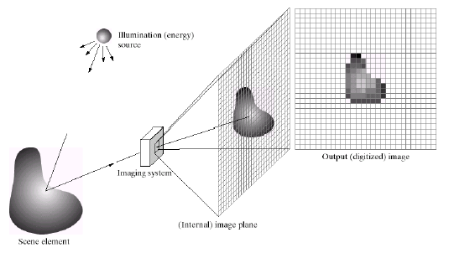
Image Acquisition

Slide 3
Image Description
f (x,y): intensity/brightness of the image at spatial coordinates
(x,y)
0< f (x,y)<∞ and determined by 2 factors:
illumination component i(x,y): amount of source light
incident
reflectance component r(x,y): amount of light reflected by
objects
f (x,y) = i(x,y)r(x,y)
Where 0< i(x,y)<∞: determined by the light source
0< r(x,y)<1: determined by the characteristics of objects

Slide 4
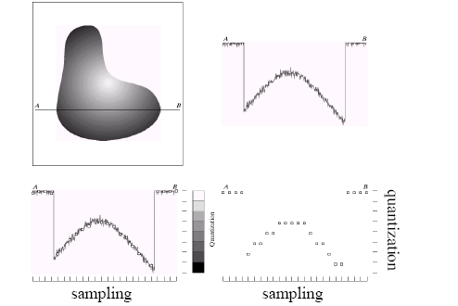
Sampling and Quantization

Slide 5
Sampling and Quantization
Sampling: Digitization of the spatial coordinates (x,y)
Quantization: Digitization in amplitude (also called gray-level
quantization)
8 bit quantization: 2⁸ =256 gray levels (0: black, 255: white) Binary (1 bit quantization):2 gray levels (0: black, 1: white)
Commonly used number of samples (resolution)
Digital still cameras: 640x480, 1024x1024, up to 4064 x 2704
Digital video cameras: 640x480 at 30 frames/second 1920x1080 at
60 f/s (HDTV)

Slide 6
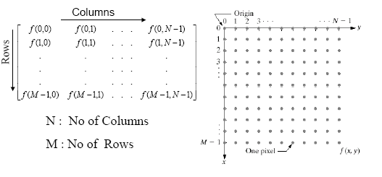
Sampling and Quantization
Digital image is expressed as

Slide 7
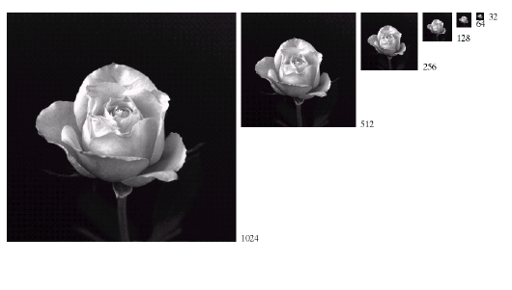
Sampling

Slide 8
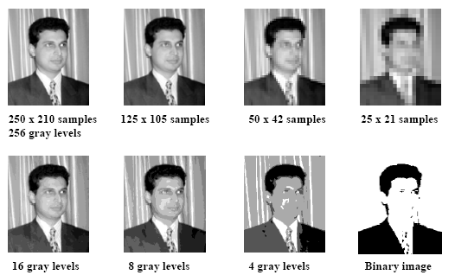
Effect of Sampling and Quantization

Slide 9
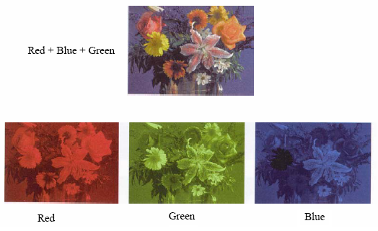
RGB (color) Images

Slide 10
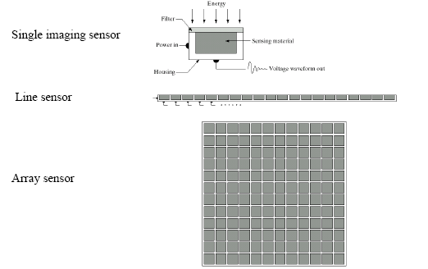
Image Acquisition

Slide 11
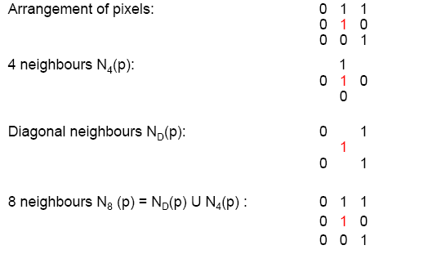
Basic Relationships between Pixels

Slide 12
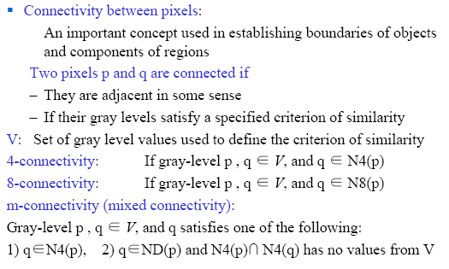
Basic Relationships between Pixels
ND= Diagonal Neighbors
Notes:
ND= Diagnol Neighbors

Slide 13
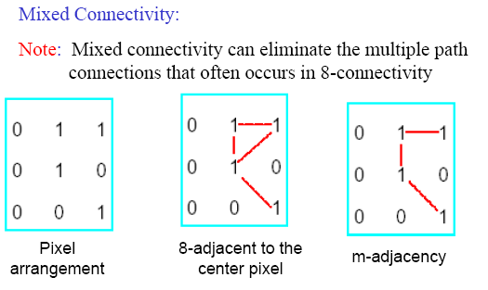
Basic Relationships between Pixels

Slide 14
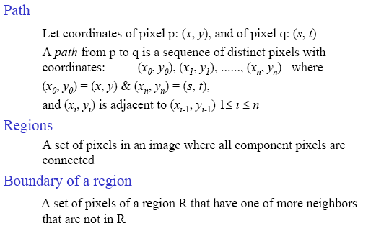
Basic Relationships between Pixels

Slide 15
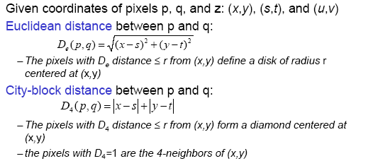

Distance Measures
Chessboard distance between p and q:

